Slide 1
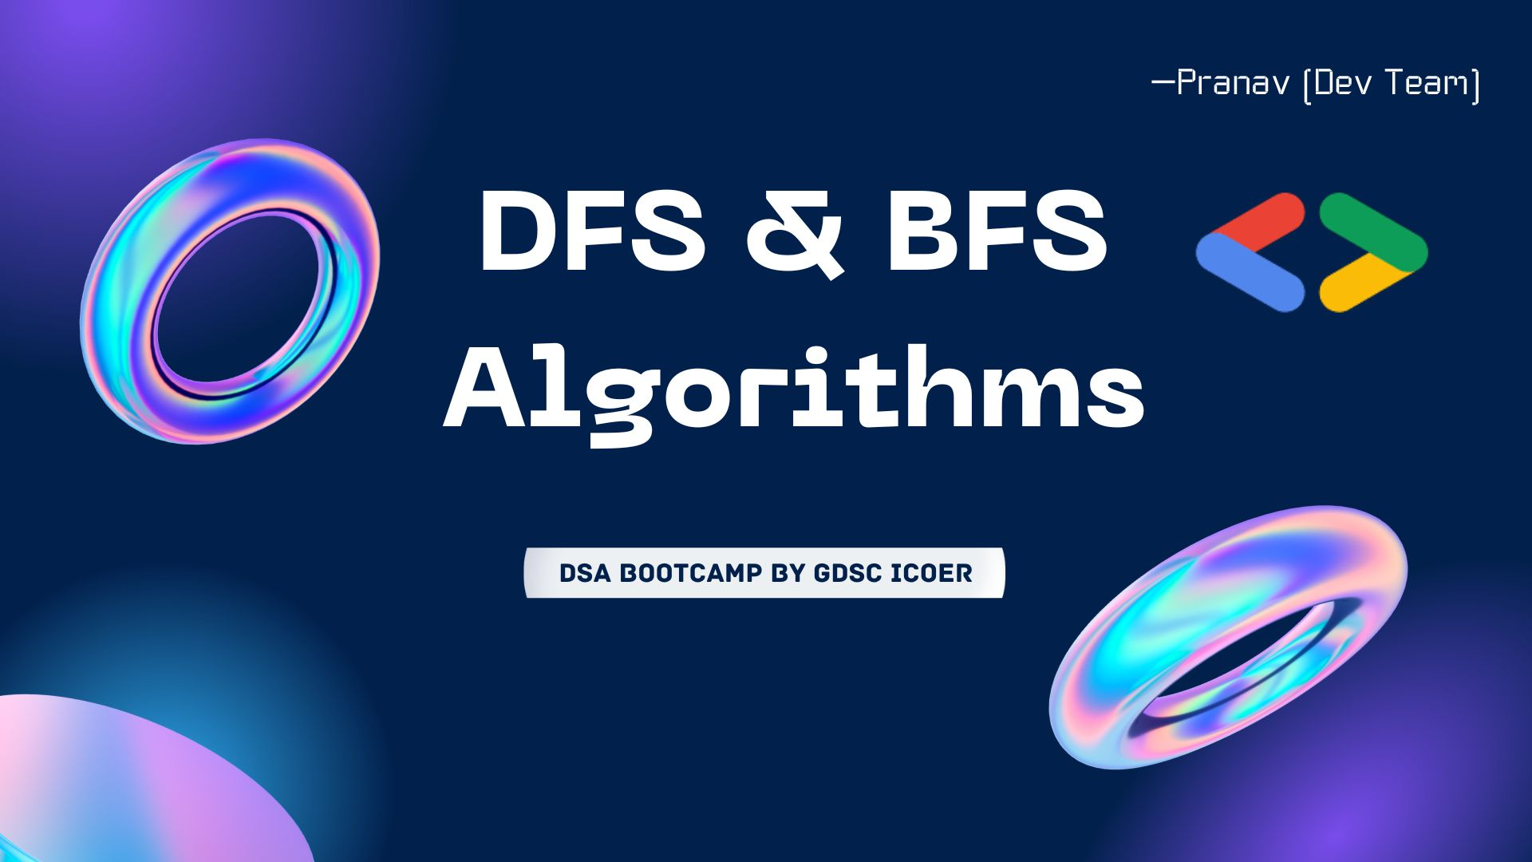

DSA Bootcamp GDSC
DFS and BFS Algorithms
Discover the power of Depth-First Search (DFS) and Breadth-First Search (BFS) algorithms in computer science. Explore key concepts, comparisons, and real-world applications.
- Pranav(GDSC Dev Team)

Slide 2

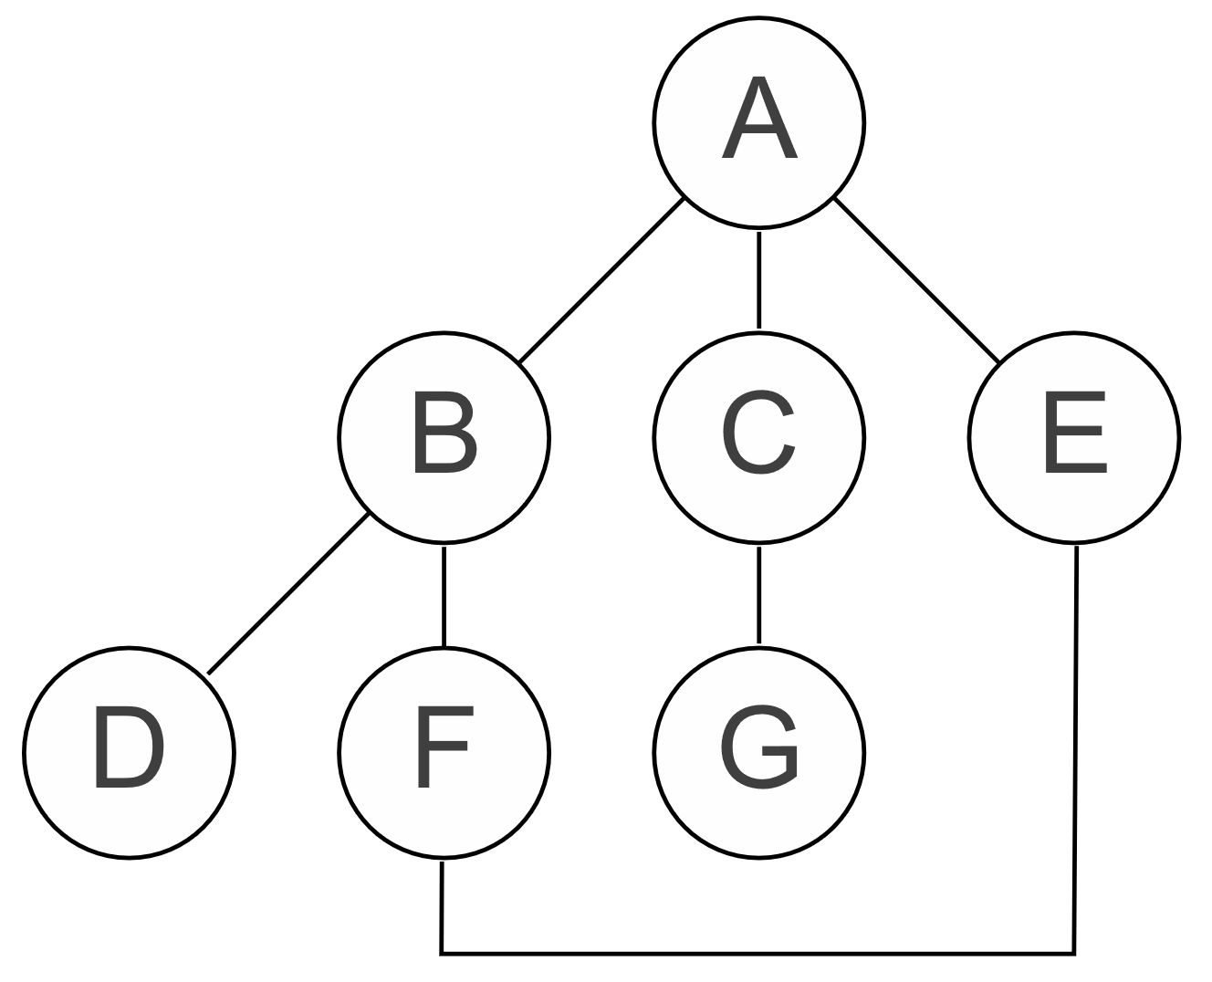
Key Concepts and Definitions
Graph
Traversal
A graph is a collection of nodes and edges that connect them, representing relationships between entities.
Traversal is the process of visiting all nodes in a graph or tree, following specific rules or algorithms.
Connected Component
Shortest Path
A connected component is a subgraph in which every pair of nodes is connected by a path.
The shortest path is the path with the minimum number of edges between two nodes in a graph.

Slide 3

Depth-First Search (DFS)
1
Definition
DFS is a graph traversal algorithm that explores as far as possible along each branch before backtracking.
Process
2
It starts at the root node and visits nodes as far as possible before backtracking.
3
Applications
DFS can be used to solve problems like finding connected components, detecting cycles, and solving puzzles.

Slide 4

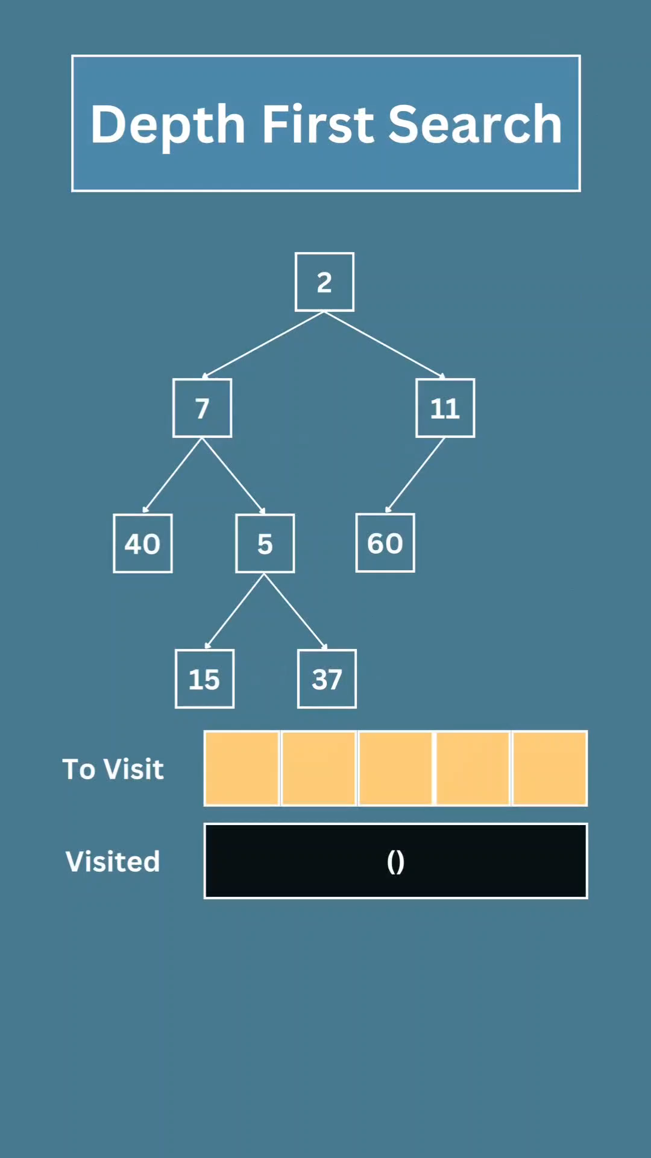
DFS Algorithm
1. Start at an initial node.
2. Explore an unvisited neighbor of the current node.
3. If there are unvisited neighbors, continue to step 2, going deeper into the graph.
4. If there are no unvisited neighbors, backtrack to the previous node and explore any remaining unvisited neighbors.
5. Repeat steps 2 to 4 until you've visited all nodes or achieved your specific goal.

Slide 5
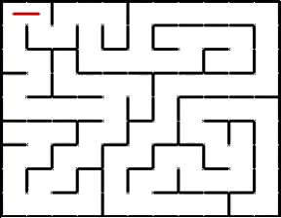
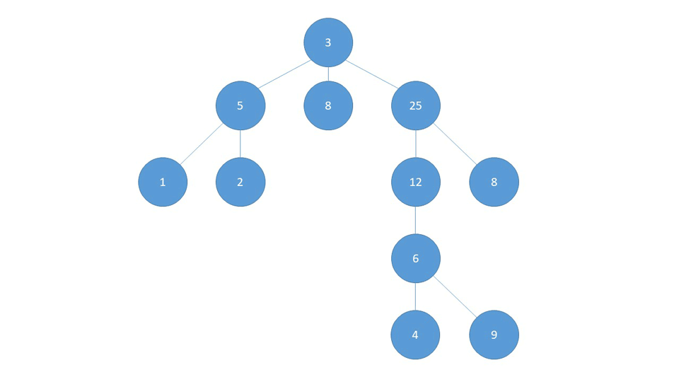
Applications of DFS
1
Maze Solving
DFS can be used to solve mazes by exploring paths until a solution is found.
2
Topological Sorting
DFS can help in determining the order of tasks or dependencies in a graph.
3
Graph Connectivity
DFS can identify connected components and determine if a graph is connected.

Slide 6


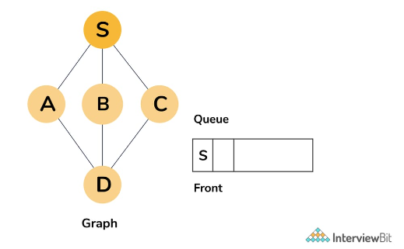
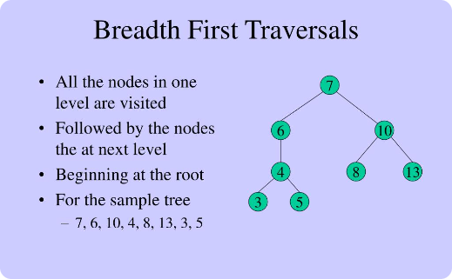
Breadth-First Search (BFS)
Definition
Process
Applications
BFS is a graph traversal algorithm that visits all the vertices of a graph in breadth-first order.
It starts at the root node and visits the nodes at the current depth level before moving to the next level.
BFS is commonly used to find the shortest path, minimum spanning tree, and solving puzzles with the least number of moves.

Slide 7

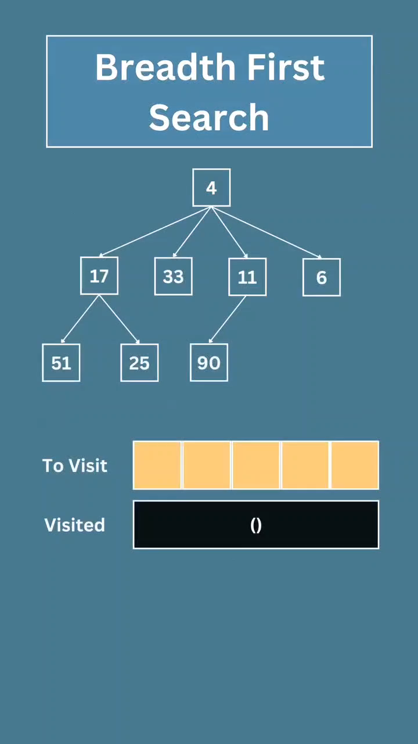
BFS Algorithm
1. Start at the initial node.`
2. Explore all unvisited neighbors of the current node at the same level.
3. Move to the next level and explore their unvisited neighbors.
4. Continue this level-by-level exploration until you've visited all nodes at the current level.
5. Once a level is fully explored, move to the next level and repeat steps 2 to 4.
6. Keep track of visited nodes to avoid revisiting them.

Slide 8
Applications of BFS
Network Crawling
Shortest Path
Social Network Analysis
BFS can be used to crawl web pages or explore networks systematically.
BFS can find the shortest path between two nodes in an unweighted graph.
BFS can help in analyzing social networks, identifying clusters, and finding connections.
Geographic Information Systems (GIS)
BFS can be used for finding the shortest path in road networks, finding the closest facilities, and performing location-based services.

Slide 9

Comparison between DFS and BFS
DFS
BFS
Depth-first traversal
Breadth-first traversal
Uses stack
Uses queue
Can get stuck in infinite loops
Guaranteed to terminate for finite graphs
Ideal for exploring deep paths
Ideal for finding the shortest path
it might not explore all nodes in the same component consecutively
it explores all nodes in one connected component before moving to the next
DFS typically uses less memory space
BFS uses more memory space

Slide 10
DFS
BFS
#include <iostream>
#include <vector>
#include <stack>
#include <set>
using namespace std;
void dfs(vector<vector<int>>& graph, int start) {
int numNodes = graph.size();
vector<bool> visited(numNodes, false);
stack<int> s;
s.push(start);
while (!s.empty()) {
int node = s.top();
s.pop();
if (!visited[node]) {
cout << node << " "; // Process or print the node
visited[node] = true;
for (int neighbor : graph[node]) {
if (!visited[neighbor]) {
s.push(neighbor);
}
}
}
}
}
int main() {
int numNodes = 7;
vector<vector<int>> graph(numNodes);
graph[0] = {1, 2};
graph[1] = {0, 3, 4};
graph[2] = {0, 5, 6};
graph[3] = {1};
graph[4] = {1};
graph[5] = {2};
graph[6] = {2};
cout << "DFS starting from node 0: ";
dfs(graph, 0);
return 0;
}
#include <iostream>
#include <list>
#include <queue>
class Graph {
int V;
std::list<int> *adj;
public:
Graph(int V);
void addEdge(int v, int w);
void BFS(int s);
};
Graph::Graph(int V) {
this->V = V;
adj = new std::list<int>[V];
}
void Graph::addEdge(int v, int w) {
adj[v].push_back(w);
}
void Graph::BFS(int s) {
bool *visited = new bool[V];
for (int i = 0; i < V; i++)
visited[i] = false;
std::queue<int> queue;
visited[s] = true;
queue.push(s);
while (!queue.empty()) {
s = queue.front();
std::cout << s << " ";
queue.pop();
for (auto i = adj[s].begin(); i != adj[s].end(); ++i) {
if (!visited[*i]) {
visited[*i] = true;
queue.push(*i);
}
}
}
}
int main() {
Graph g(4);
g.addEdge(0, 1);
g.addEdge(0, 2);
g.addEdge(1, 2);
g.addEdge(2, 0);
g.addEdge(2, 3);
g.addEdge(3, 3);
std::cout << "BFS starting from vertex 2: ";
g.BFS(2);
return 0;
}
Problem Statments

Slide 11

Some Interview Questions
In a weighted graph, how can you find the shortest path using DFS? What are the challenges of using DFS for this purpose?
Why BFS uses queue and DFS uses stack?
Explain the concept of backtracking in the context of DFS
and how it is used in problem-solving.

Slide 12

Resourses
Interviewing.io
Interviewbit.com
Geekforgeeks.org
Fullstack.cafe
Tutorialhorizon.com
TheAlgorists.com

Slide 13




